Slide 1
1st national network of entities for entrepreneurship and self-employment
25/5/2023

Slide 2
Índice
Youth Business Spain Session.
Youth Business International Mentoring Methodology
Impact Report of YBS Mentoring Program
Gaztenpresa Experience in the Basque Country (Inma Ramos)
Collaboration Opportunities

Slide 3
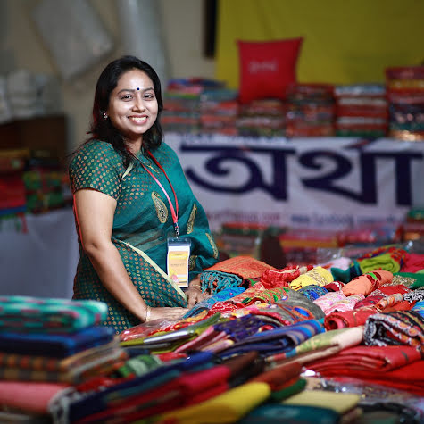
Youth Business International
Youth Business International (YBI) sits at the centre of a global network of business support organisations.
This gives us a unique perspective on youth entrepreneurship across the world.
YBI acts as a platform for these organisations to exchange ideas, knowledge and insights.

Slide 4
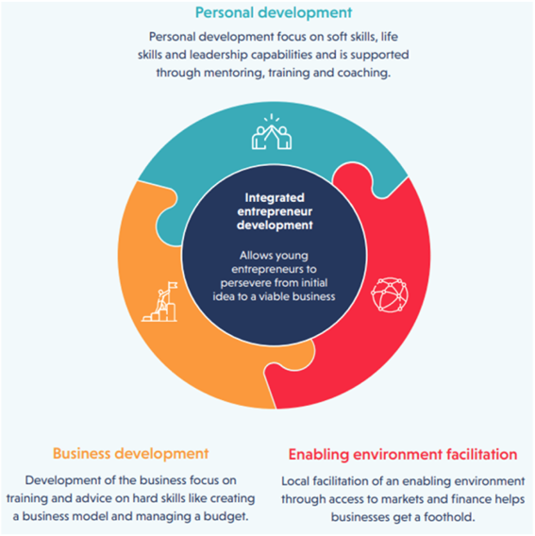
Model for success
Our network is powered by organisations with a passion for empowering young people to start, scale and sustain their businesses.
Locally-led, these organisations offer young people a range of personal and business development support as well as activities that enable an environment in which to thrive.

Slide 5
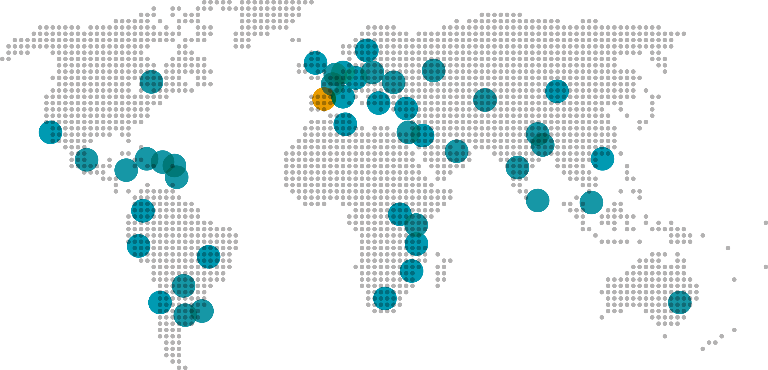
Where we work

Slide 6
Our 20 year history
Programme Builder
Network Developer
Global Leader
In 2000, YBI was established as a result of International interest in the Princess’ Trust’s work in the United Kingdom, presenting youth entrepreneurship as a solution for youth unemployment. YBI focused on developing organizations with a focus on helping disadvantaged young people to become entrepreneurs through training and mentoring. Incubated by the International Business Leaders Forum, YBI became an independent international NGO in 2008.
Their current programme focus areas emphasize technical preparation for the future of work and the integration of soft skills while accelerating digital adoption.
YBI the began to take a more concerted approach to grow its network of independent expert organizations and fostering innovation and collaboration across the network. Their facilitation of the network’s knowledge and solutions sharing serves to ignite increased impact, with strong support ecosystems developed in Latin America, Europe and Sub-Saharan Africa.
Today, YBI has 52 members in 46 countries, in addition to partners who have supported members and the youth they serve in key programmatic areas.
Building on 20 years of experience, YBI has demonstrated leadership in the field of youth entrepreneurship. In the context of the widespread prevalence of youth unemployment, worsened by the pandemic, they have been able to steward the movement towards supporting young people develop as entrepreneurs by facilitating knowledge sharing across their network and advocating for programs that address the whole person.
Moving forward, they will continue to evolve an scale their programme with the aim yo reach more young people and encourage more inclusive programming and social and green entrepreneurship.

Slide 7
YBI 2022 impact
Our work enables aspiring young entrepreneurs to start and grow enterprises which in turn creates jobs, bring innovative products and services to communities and drives local economic growth.
123,487
young people supported by our network
49,000
jobs were created
16,461
young people matched to mentors
Powerful partnerships
Argidius Foundation, EEA, Enel, Google.org, IKEA Foundation, Standard Chartered Foundation
Through our Covid Rapid Response and Recovery Programme 113,165 entrepreneurs reported improved business knowledge and skills to manage risk, 103,796 businesses were still trading at the end of the programme and 92,803 jobs were saved.
35,472
strengthened a business
14,923
young people started business
2017 figures

Slide 8
YBS: a collective initiative
Youth Business Spain is the member in Spain . We born as a result of the alliance of entrepreneurship support organisations that, after implementing a pilot in Madrid and Barcelona, ​​decided to start a new entity.
YBS is focus in:
Support one od the group with the greatest problems and needs young people
In the most urgent area: employment.
Through the promotion and development of an ecosystem of local entities working to face youth unemployment.
Providing methodologies, tools and the experience of social entities that successfully face the problem

Slide 9
Youth Business Spain cooperation model

Strategic partners are public administrations, private companies and institutions that provide finance, knowledge and services to YBS to strengthen, grow and improve the network and the local delivery partners activities.
Local delivery partners are non-profit, private and independent organizations supporting locally young entrepreneurs through training, access to finance and mentoring programmes.
Operational partners are public administrations, companies and institutions, collaborating with local delivery partners in developing training activities, access to funding and mentoring.
✓
☞

Slide 10
Offer of services for entrepreneurs
Impacto Local
Training
Mentoring
Financing
YBS members offer support to entrepreneurs in:
Business Model Canvas
digital transformation
personal skills
Green and social business
Personalized accompaniment by experienced entrepreneurs or professionals who voluntarily help entrepreneurs in starting up and consolidating businesses.
Social Microcredits for people with difficult access to traditional banking
Guidance, accompaniment and intermediation with financial entities
financial culture

Slide 11
The YBS Mentoring Program
OVER 3,500 MENTORING RELATIONSHIPS!
3,340 beneficiary companies in Spain
2,290 mentors volunteers in Spain
Survival rate after the first 5 years of 87%, more than double the national average.

Slide 12
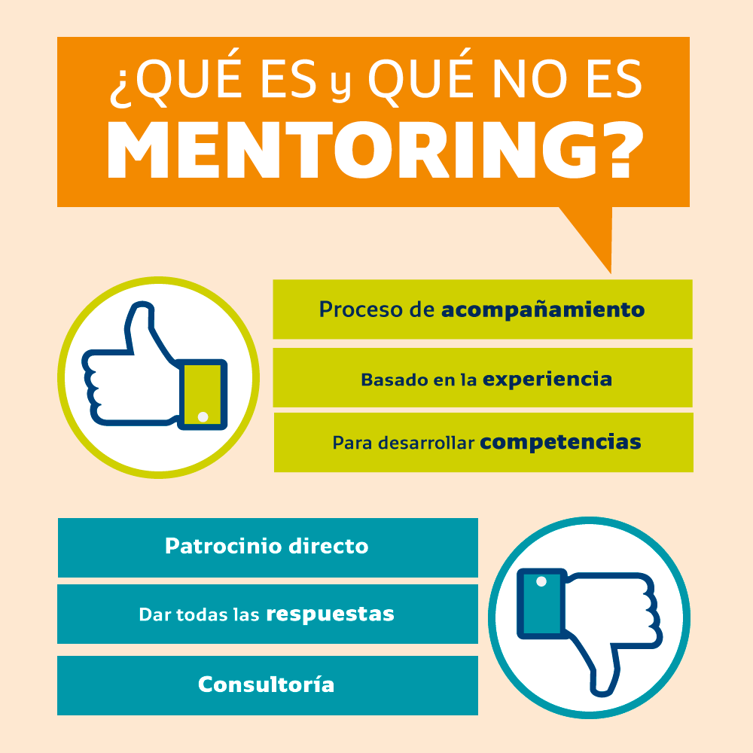
The YBS Mentoring Program
Personalized accompaniment through which experienced businessmen and professionals accompany young people as volunteers during the first year of their business adventure.
Mentoring is based on the creation of a space of trust to help young entrepreneurs to identify and face the challenges that their business faces, based on joint reflection, promoting the development of their skills and fostering their personal growth. and professional.
The role of the mentor is not to give advice or act as a consultant, but rather to help young people to reflect in order to find solutions for themselves.

Slide 13
The YBS Mentoring Program
Volunteer: Mentors participate with the sole purpose of helping, without expecting anything in return. They are independent and neutral, have no conflicts of interest.
Individual: It is a one-on-one mentoring, each entrepreneur is assigned a mentor. Both have the support of a mentoring manager.
Experience: Mentors share their personal, professional and business experience with the entrepreneur. The experience differential is key.
Holistic: Mentoring addresses the business as a whole. It is not a specialized technical consultancy.
Non-directive: Mentors help entrepreneurs to reflect in order to make their own decisions. They do not impose their opinions.
Transformational: Mentors help entrepreneurs develop their skills to grow personally and professionally. It is not simply an exchange of knowledge.
Temporary: Mentoring relationships have a specific duration. It is about promoting the autonomy of entrepreneurs so that they are self-sufficient.
Impacto Local

Slide 14
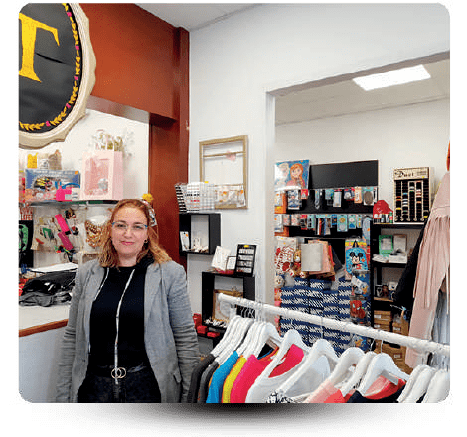
Profile of entrepreneurs
Young
With little professional experience
With little knowledge and experience in business management
With motivation and commitment
With temporary availability
I recommend the YBI mentoring program because you always feel accompanied, but at no time do you stop captaining your own ship.
Martha Mandolini
“Thanks to the YBS Mentoring program I have managed to grow personally and professionally. with the help of me
mentor I have been able to get more performance to my business."
Angela Maria Cairos

Slide 15
Profile of entrepreneurs
Entrepreneurs profile:
Preferably young people between 18-35 years old
With a business idea
Migrants, women and underserved people
With no training in business management or entrepreneurial experience
Right attitude to receive support
What kind of businesses does YBS support?
Micro-enterprises with 1 to 5 employees
“Traditional” businesses, start-ups or social enterprises

Slide 16
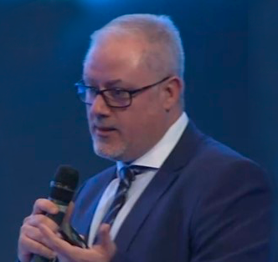
Profile of mentors
Mature person
With extensive professional experience
With knowledge and experience in business management
With communication and interpersonal skills
With motivation and commitment
With temporary availability
“Acting as a mentor in the project of an entrepreneur is essential to help consolidate their business. Being a mentor at YBS has been a fantastic experience.”
Juan Andres Ortiz. YBI European Mentor of the Year 2021
Being a mentor I have discovered new ways of working. Mentoring is a win-win experience that helps both parties in their personal and professional development.
Faustino Lorenzo Ciércoles, specialist in infrastructure and networks Iberia (Endesa)

Slide 17
Mentoring focuses
Comunicación marketing
Estrategia
Ventas
Competencias personales
Producción / Servicios
Económica-financiera
Organizativa

Slide 18
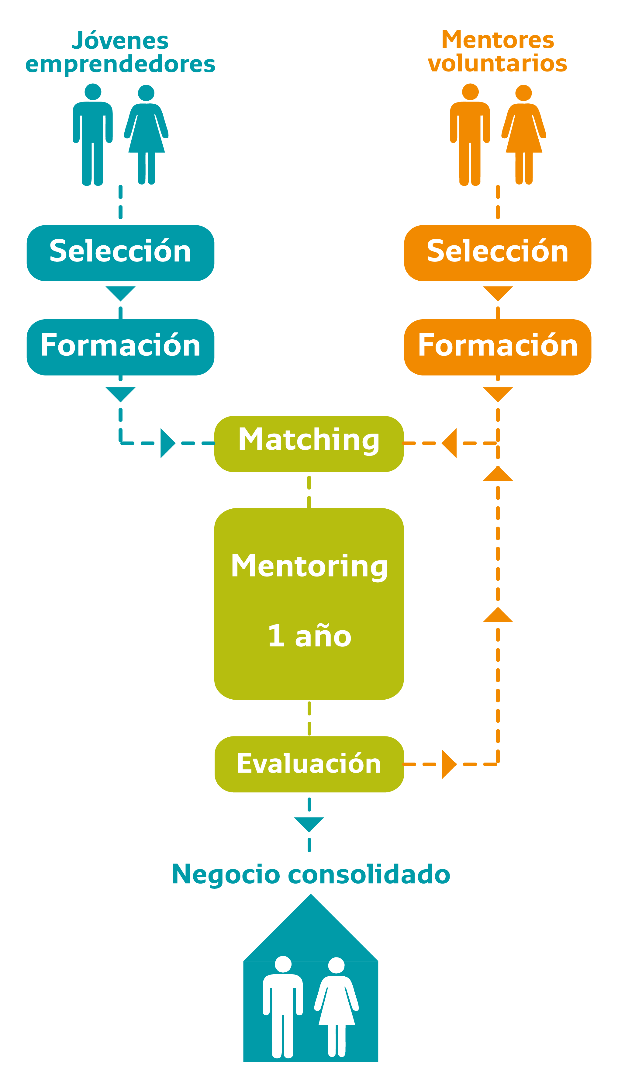
Mentoring process
YOUNG BUSINESS MENTORING | BUSINESS MENTORING OF LONGER TRAVEL
Duration 1 year, extendable. Minimum monthly frequency Accompany in the first stage of the business. Help face the challenges they face, based on joint reflection, promoting the development of their skills and fostering their personal and professional growth. Monitoring and evaluation: - Call between the 1st and 2nd month - Follow-up questionnaire (quarterly) - Follow-up meeting (6 months) - Evaluation meeting + Final evaluation questionnaire | Duration 6 months, extendable. Biweekly recommended frequency Help diagnose the business situation, identifying strengths, weaknesses, opportunities and threats. Evaluate different alternatives for action, design an action plan and accompany the application of the action plan. Monitoring and evaluation: - Call between the 1st and 2nd month - Follow-up in the middle of the process - Evaluation meeting + Final evaluation questionnaire

Slide 19
Delivery partners’ mentoring capacity building process
Training
On-going support
First workshop | Second workshop | Implementation support | MEL & Network exchange
Two-days training: YBS network Introduction to the mentoring methodology and process (sharing the YBS mentoring manual: process flows, training material, evaluation…) | Two-days training: Train the trainers (to deliver the mentor & mentee trainings) OMS Training Matching exercise Implementation plan | Mentoring coordinator support: Two days at the Delivery Partner offices to help in the first mentor & mentee trainings Monthly calls between the Mentoring coordinator and the Delivery Partner’s Mentoring manager | Monitoring and evaluation support Learning opportunities: Quarterly calls YBS Annual event Mentoring managers meeting

Slide 20
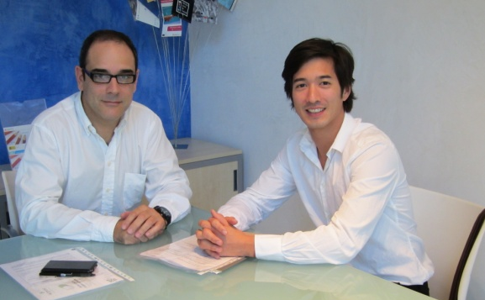
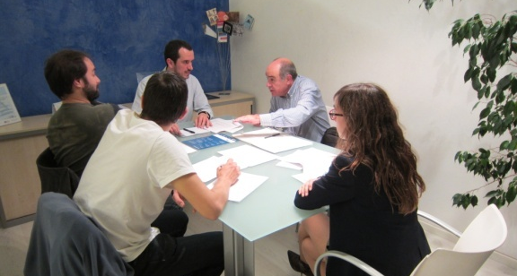
Youth Business Spain cooperation model
Mentoring is a practical approach to help young entrepreneurs develop their abilities and insights as they start and grow their own businesses
Mentoring is based on creating a safe space in which mentors help the young entrepreneurs to identify and face the challenges of their business and, by analyzing the situation together, aims to encourage the development of their skills and facilitate personal and professional growth.
Supported by:

Slide 21
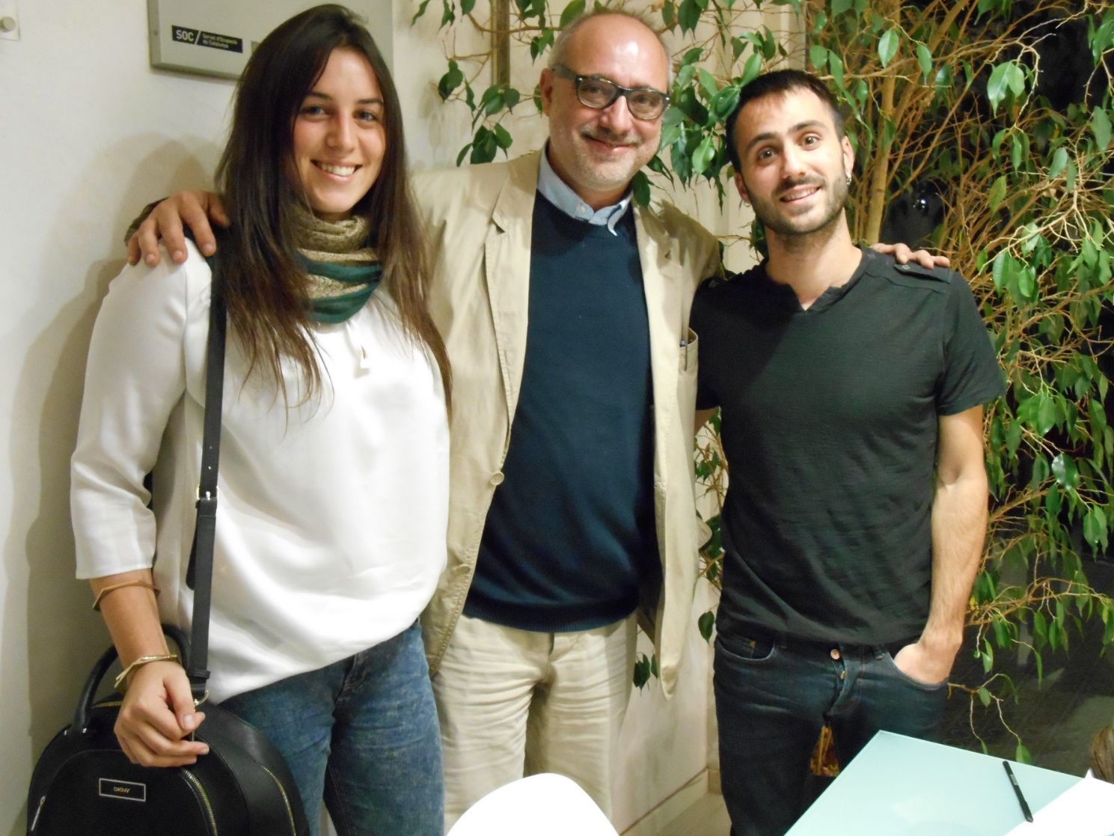
The power of mentoring for young entrepreneurs
YBI global research has shown that 84% of the entrepreneurs we have supported felt more confident running their business as a result of the non-financial support they received, and in particular mentoring

Slide 22
YBS Mentoring process
One year
MENTORING
When? biweekly/monthly
2-4 hour session
Where? entrepreneur’s business venues
OUTREACH
SELECTION
TRAINING
MATCHING
CLOSING & EVALUATION
MONITORING

Slide 23
YBS Mentoring process: Outreach
Outreach
Selection
Training
Matching
Monitoring
Evaluation
Mentors recruitment | Mentees recruitment
delivery partners contacts business associations trade unions corporate organizations | our entrepreneurship training beneficiaries private and public institutions who deliver entrepreneurship support programs: city councils universities business schools incubators youth agencies and associations
Delivering conferences, programme's presentations, etc. Entrepreneurship fairs Open networking events
How

Slide 24
YBS Mentoring process: Selection
Outreach
Selection
Training
Matching
Monitoring
Evaluation
What type of young people / businesses do we support?
Young people between 18-35
Under-served in terms of starting a business
Display entrepreneurial potential
Recently started their business
Backed up by a viable business plan
Have potential to create employment
Socially responsible / ethical activity & approach

Slide 25
YBS Mentoring process: Selection
Outreach
Selection
Training
Matching
Monitoring
Evaluation
Mentor profile
entrepreneurs or professionals
working
with entrepreneurial and business experience.
willingness to commit the time required to working on a voluntary basis and to seek the entrepreneur’s best interest.
skills to perform the mentor’s role

Slide 26
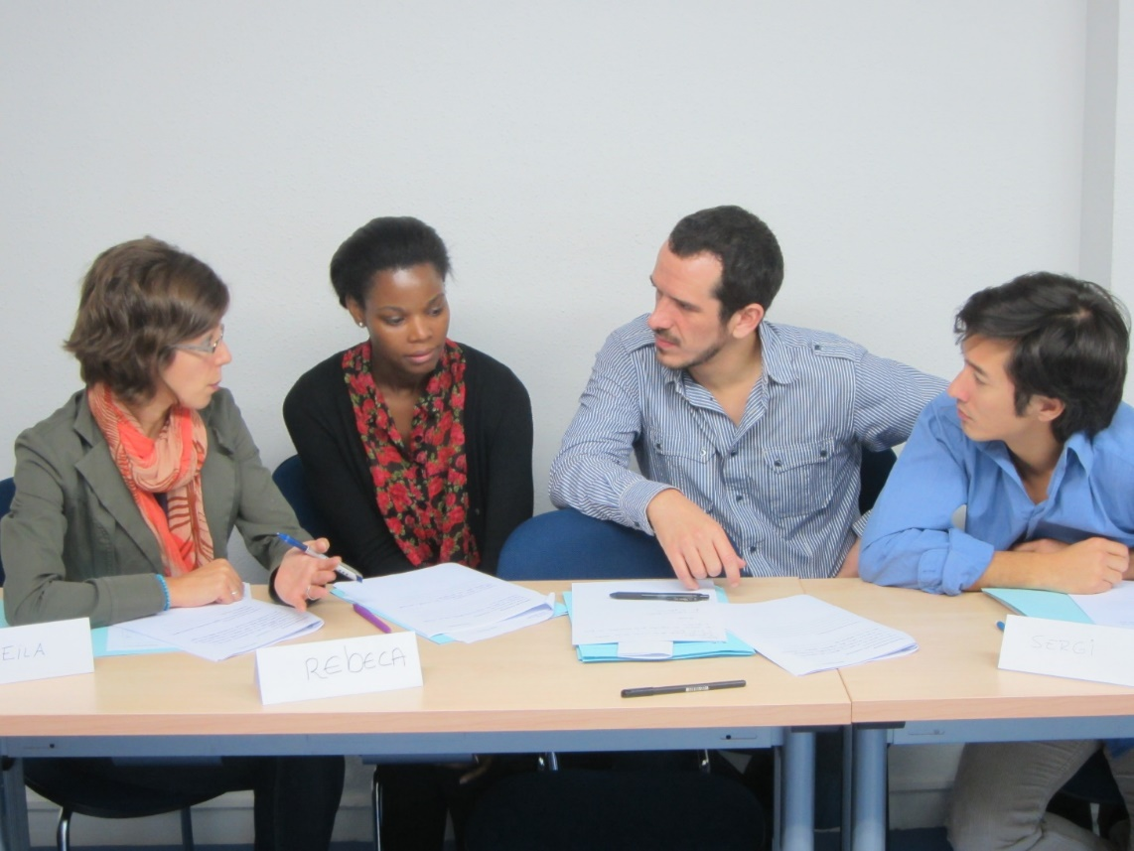
YBS Mentoring process: Training
Outreach
Selection
Training
Matching
Monitoring
Evaluation
Contents:
What is mentoring? Stages in the mentoring relationship Mentor skills and techniques How do mentors assist entrepreneurs? Dealing with challenges in the mentoring relationship Ending the relationship

Slide 27
YBS Mentoring process: Matching
Outreach
Selection
Training
Matching
Monitoring
Evaluation
Priority: meet the entrepreneur’s needs while respecting mentor’s preferences/objections
Criteria:
Mentor’s experience and knowledge suitable to help with the entrepreneur’s challenges
Compatibility (between personalities)
Availability (time and location)
Decision: taken by the mentoring manager
Mentoring agreement

Slide 28
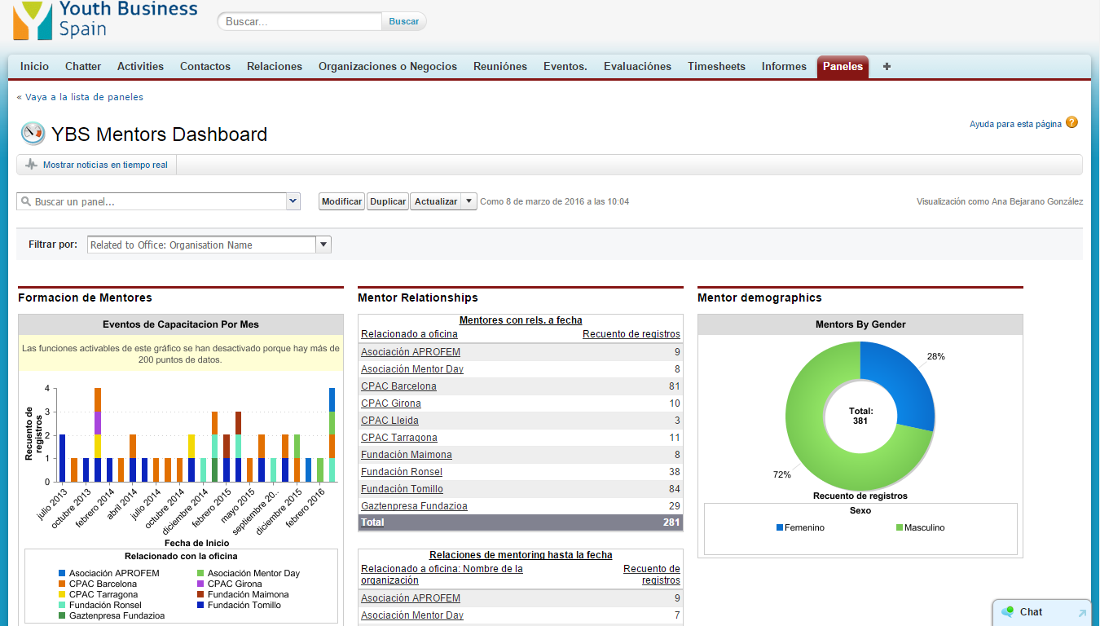
YBS Mentoring process: Monitoring
Outreach
Selection
Training
Matching
Monitoring
Evaluation
MENTORING RELATIONSHIPS
last for one year and are extendable for one more.
MONITORING:
monthly mentoring agenda
quarterly questionnaire
progress meeting after 6 months

Slide 29
YBS Mentoring process: Evaluation
Outreach
Selection
Training
Matching
Monitoring
Evaluation
“I am really happy with the relationship. It’s been positive and gratifying work. I’m not after the success of the business as much as the success of the people behind it.’” MENTOR
“The mentoring programme has helped me to learn to make decisions without fear and has given me confidence in myself to accomplish the goals that I propose.” MENTEE
‘Joining the Youth Business Spain Mentoring program has been a decisive turning point in the development of our business. Without a doubt, it is one of the most important and positive decisions I've made to date. Our mentor is “part” of our team from the first moment he was introduced to us. My mentoring relationship has been absolutely necessary!’ MENTEE
“I think it is not just about helping out. You really learn a lot as a mentor and you get to remember the different steps of your own experience. It is a good reflection.” MENTOR
“It has helped me to better focus my business, to gain efficiency, and above all to become aware and define my working model.’” MENTEE

Slide 30
Impact study report
Impact on entrepreneurs
Improvement of management knowledge: 64%
Improvement of management skills: 72%
Improvement in job satisfaction: 80%
Active working beneficiaries: 95%
Impact on business
Business in expansion / growth phase: 60%
Revenues increase: 100%
Staff increase: 60%
5-year survival rate: 87%
Impact on society
Creation of new jobs: 1.384
Tax & quotations collection: 19,8M€
Savings of unemployment benefits: 2,1M€
Measuring the socioeconomic impact of the Youth Business Spain entrepreneurship mentoring programme
The survival rate of businesses that participated in the mentoring program is 87% in the fifth year, more than the double compared to the national average (41%).

Slide 31
Strengthening the 2023 mentoring program
Evaluation of the YBS Mentoring Program by the Mentoring School and the Entrepreneurship Observatory of Spain:
The measurement of social impact will allow us to know to what extent and how the interventions deployed from the Mentoring Program generate a transformation in the different personal and professional dimensions of the people mentored, in their companies, and in the performance of the different roles of the people mentors. The information on the social impact will have the following main uses:
Increase and improve the social impact of the mentoring program.
Become aware of and have evidence of the added value of the project and its alignment with the purpose of the entity that promotes it.
Accountable to funders and the entrepreneurship ecosystem in terms of providing evidence on the scope and depth of the social transformation to which the Mentoring Program contributes.

Slide 32
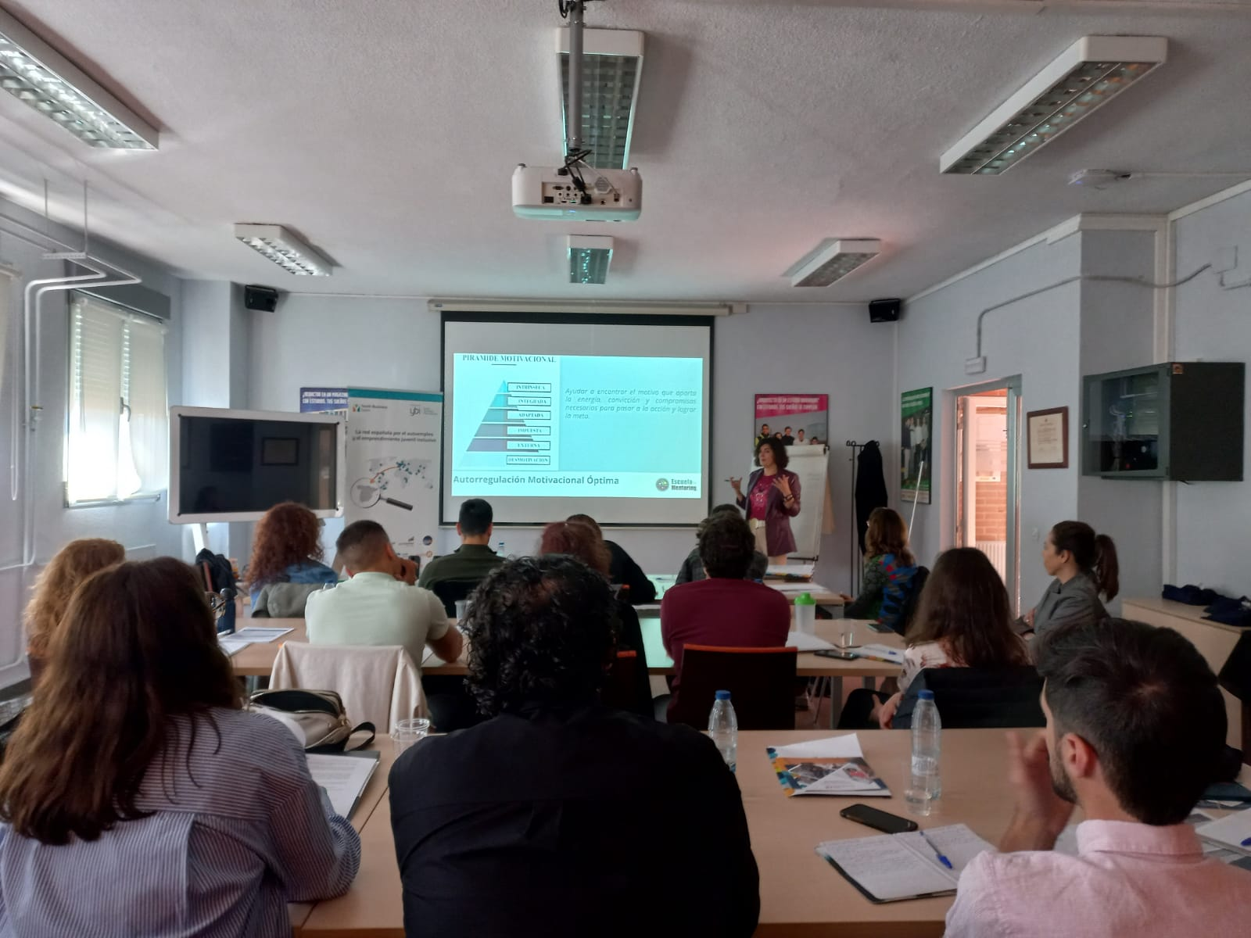
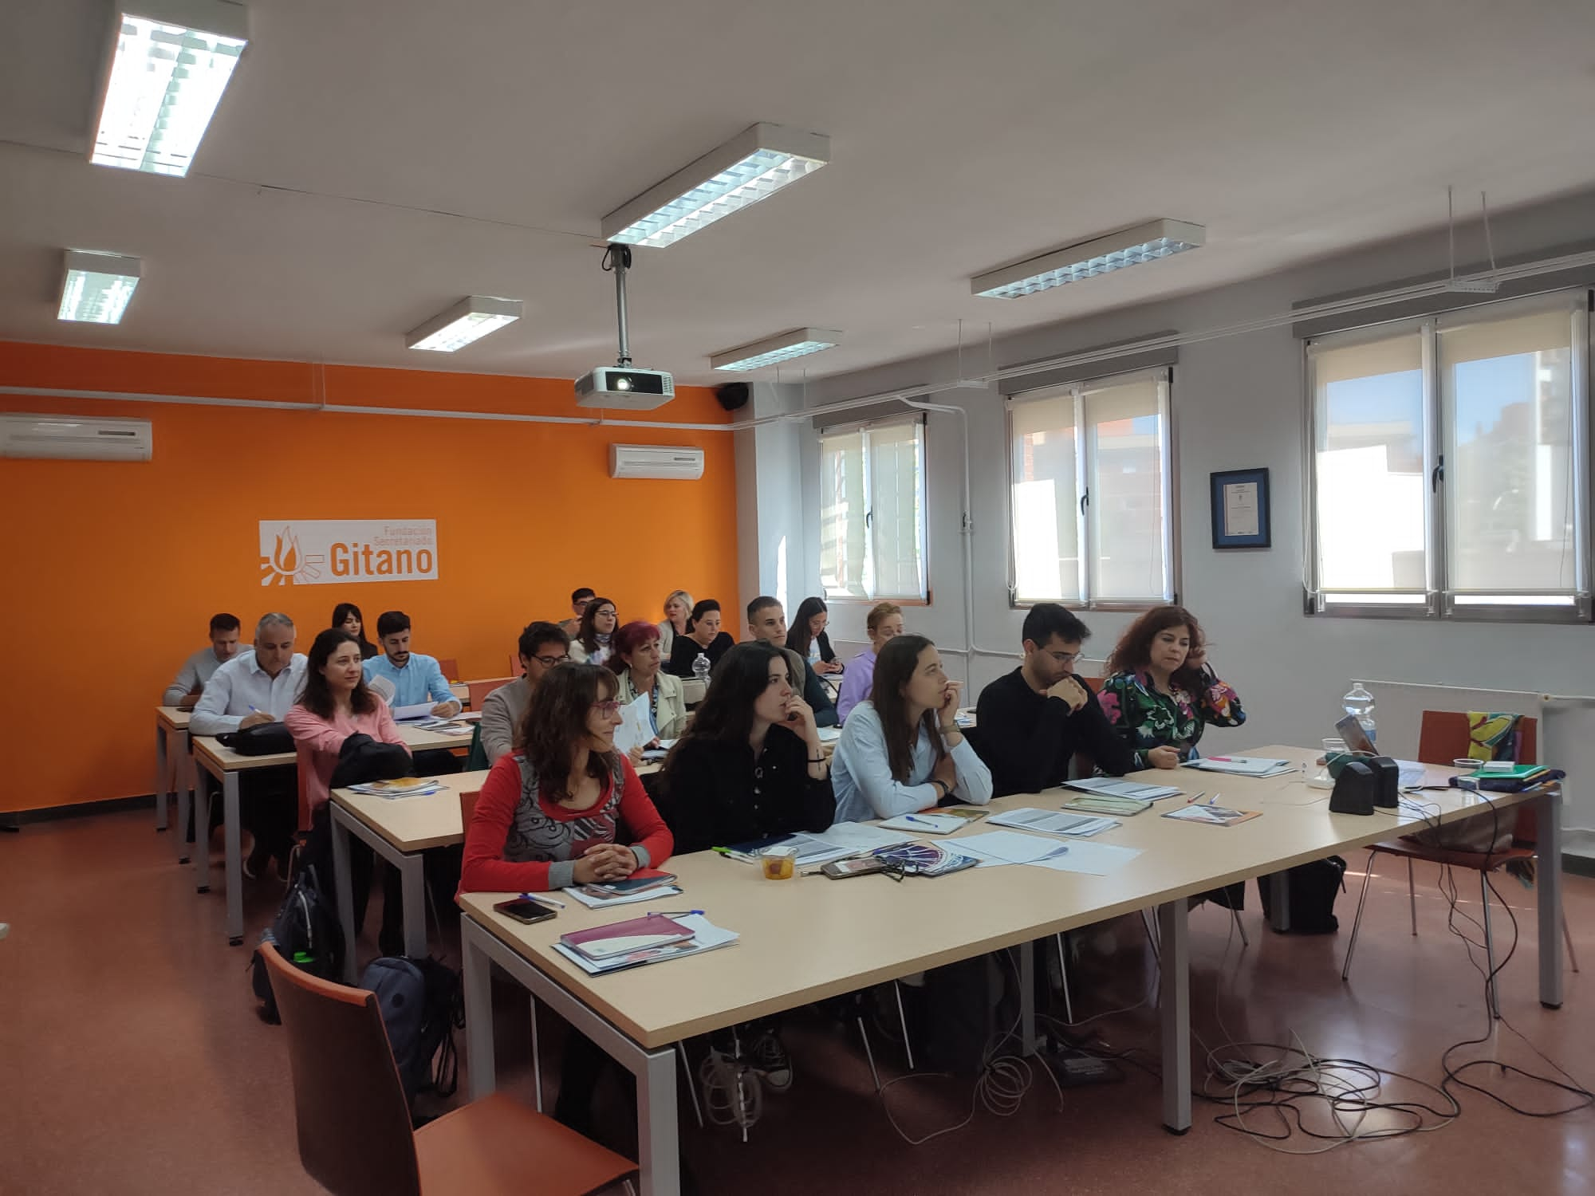
Training day-workshop for Mentoring managers from all over Spain.
On April 18, 19 and 20, 21 mentoring managers from the 12 local partners had the opportunity to share, learn and develop professionally in the mentoring workshop. The mentoring expert MªLuisa de Miguel, from the Mentoring School, has addressed fundamental aspects such as motivation and the management of emotions in mentoring processes, as well as non-directive intervention techniques, key to guiding instead of directing.
Strengthening the 2023 mentoring program

Slide 33
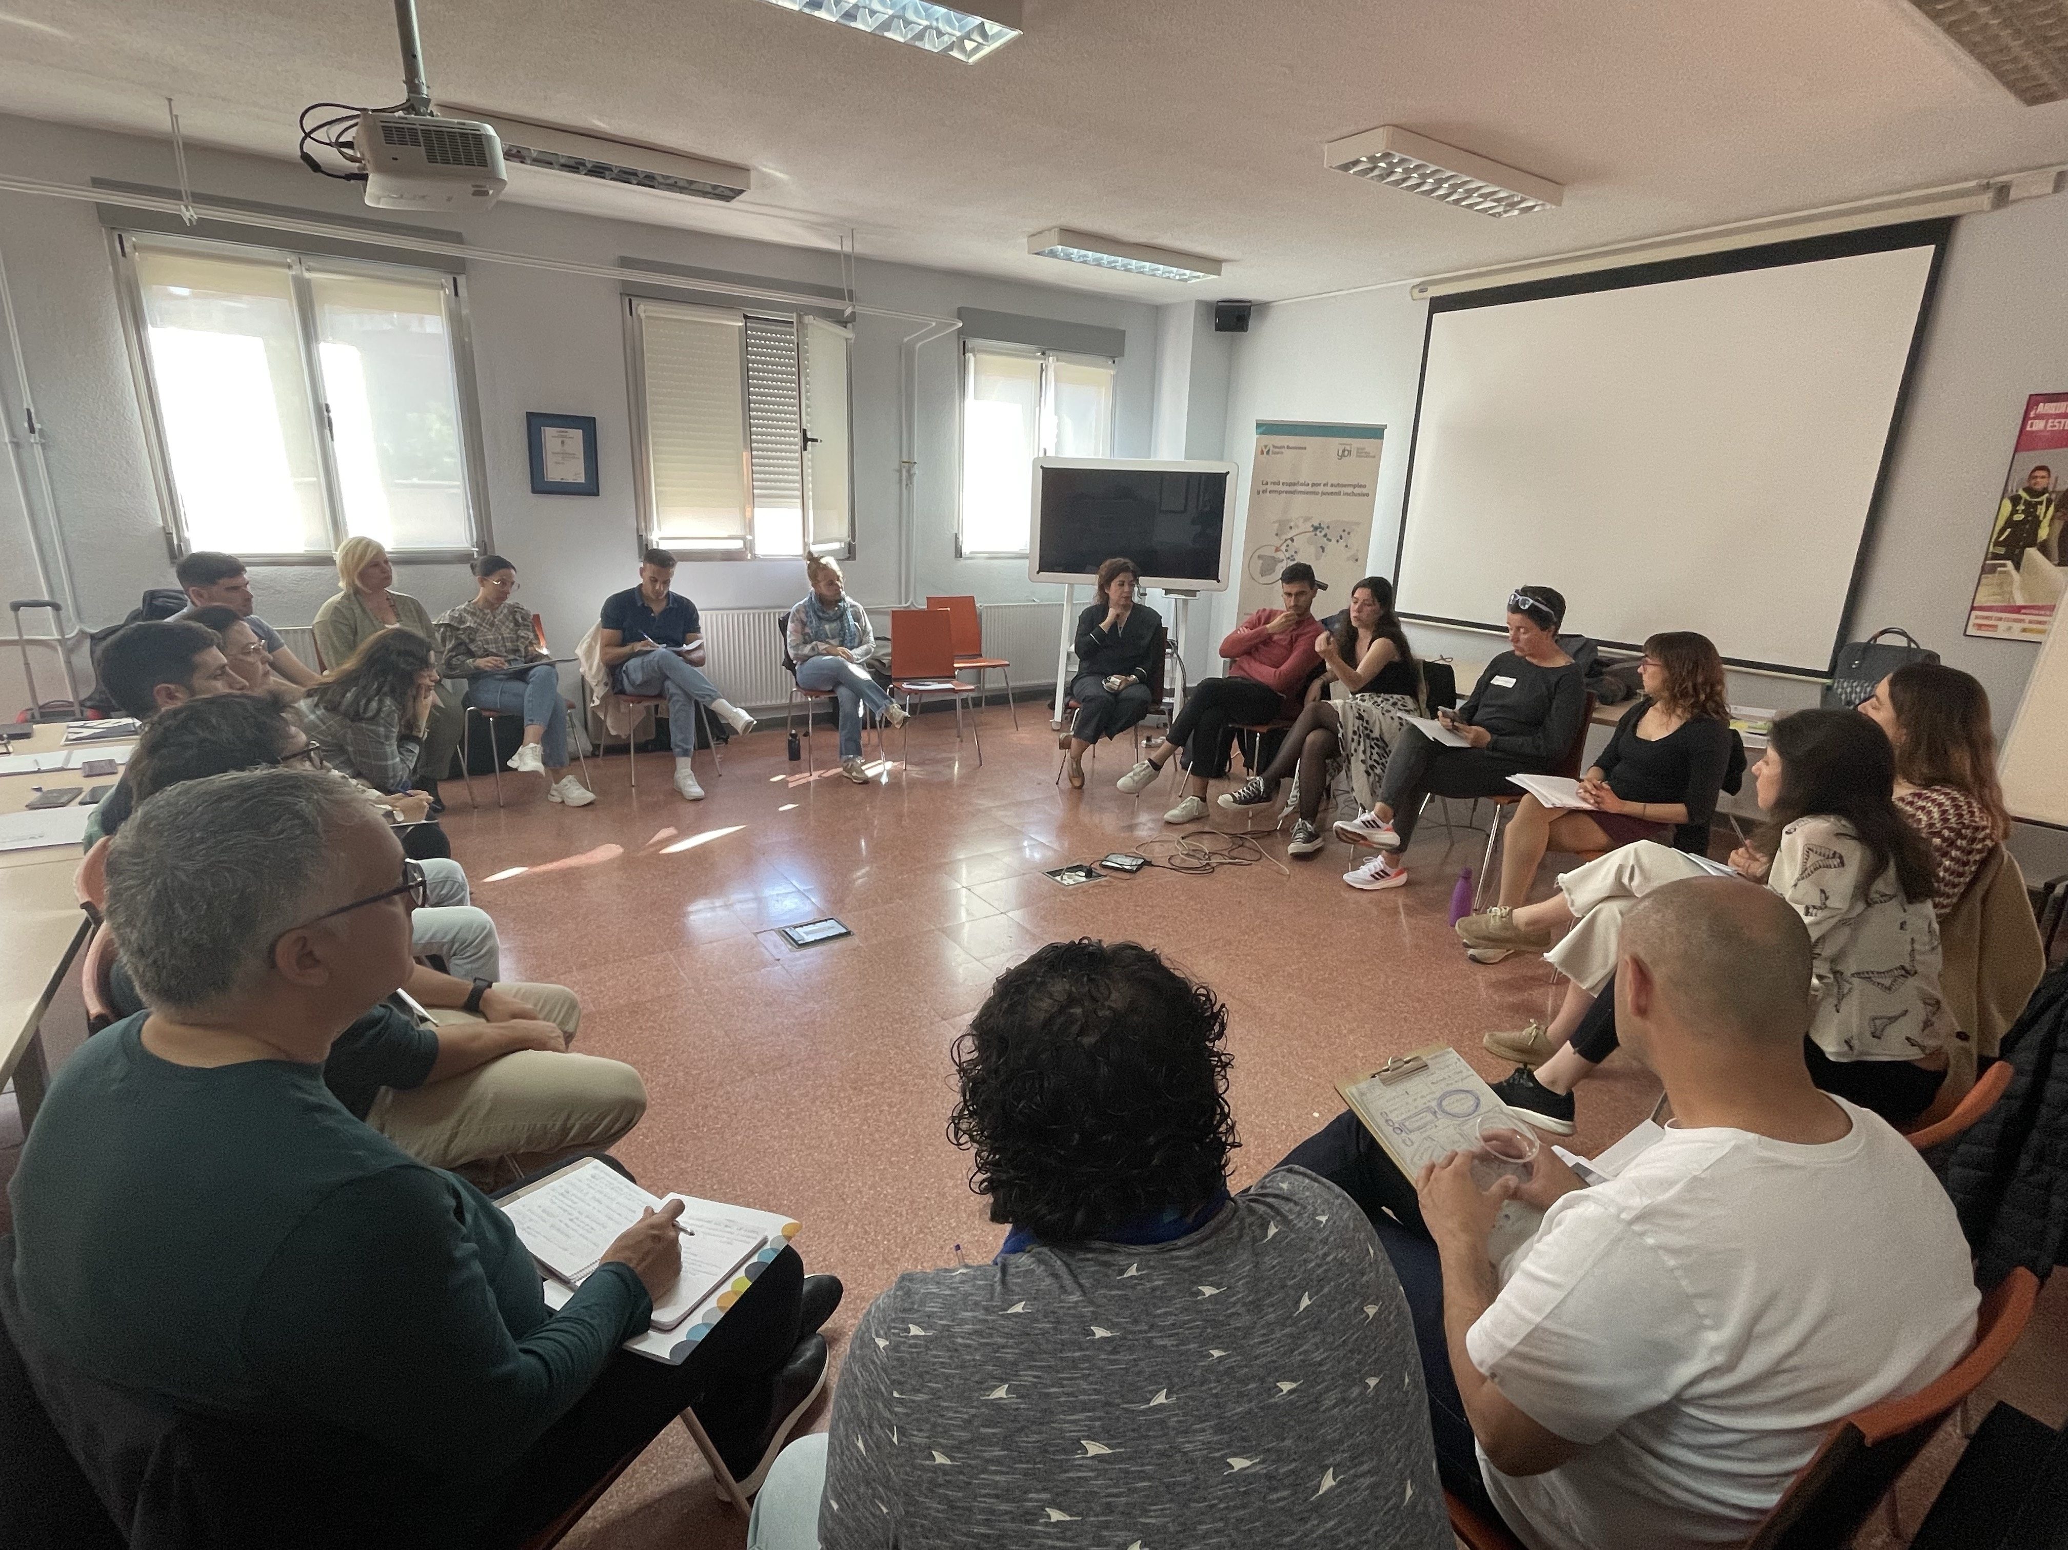
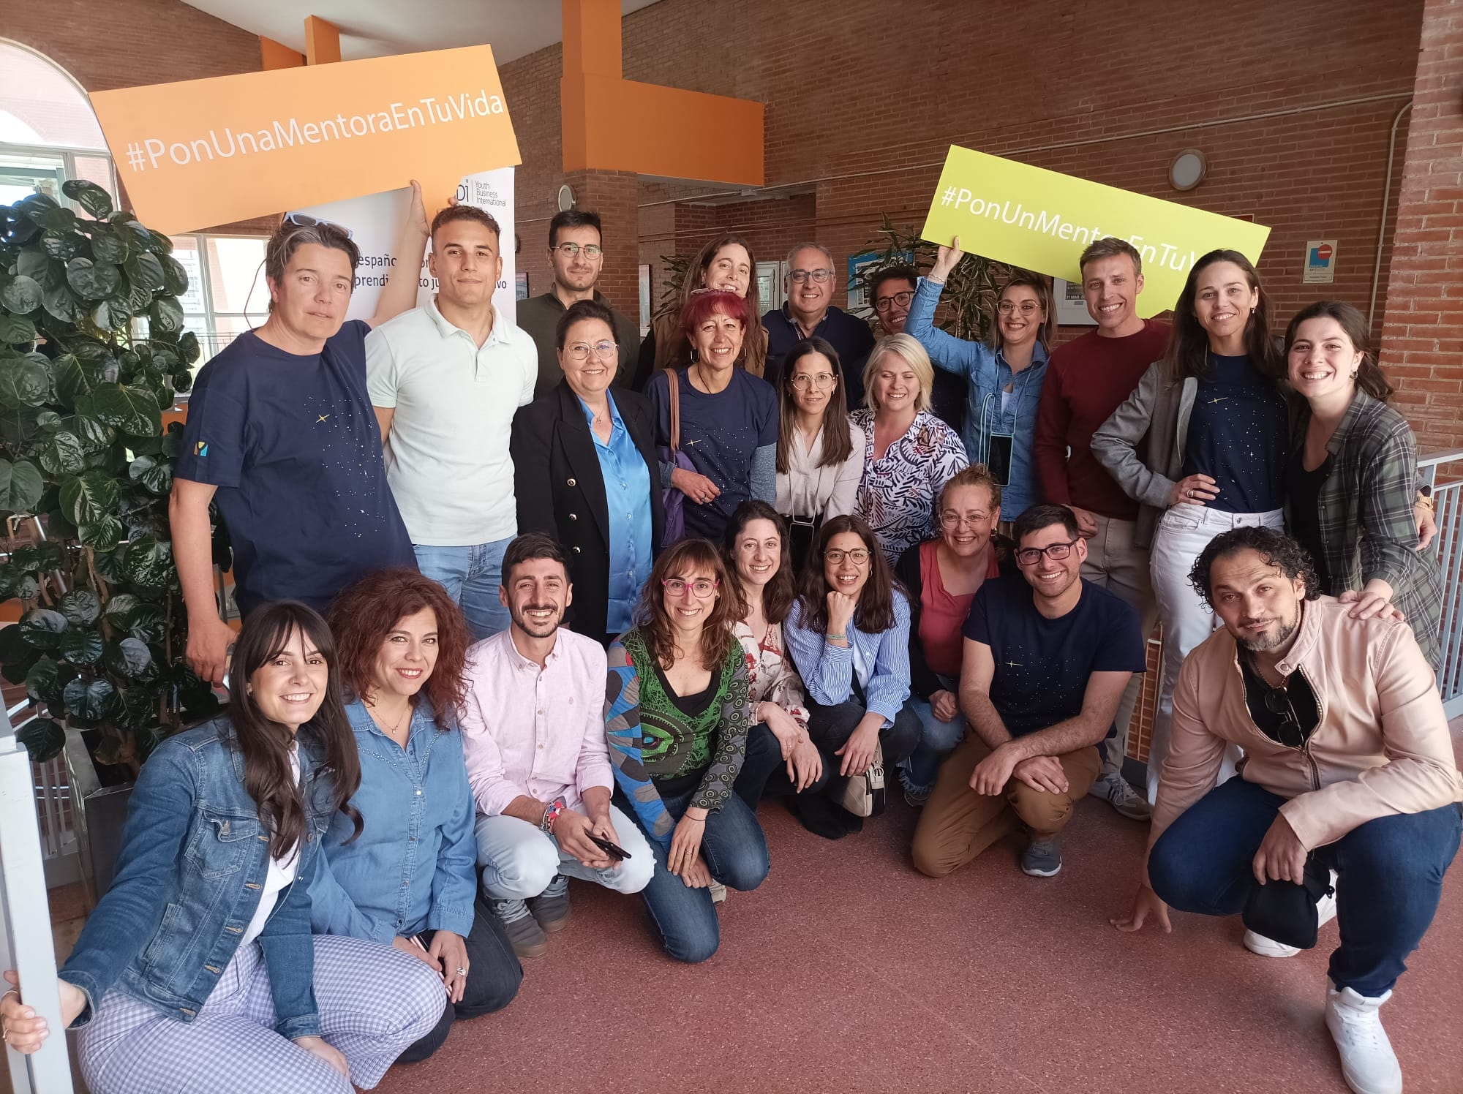
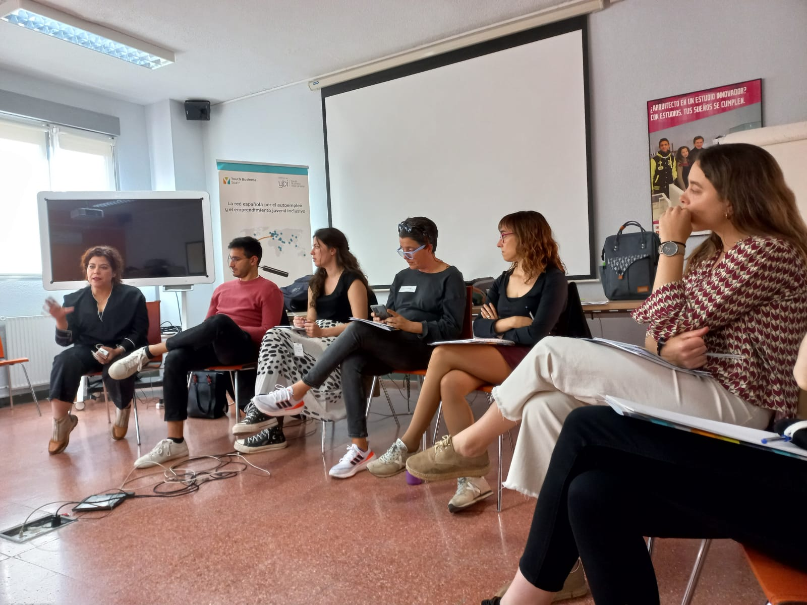
YBS Mentoring Workshop

Slide 34
Somes of our parthers
Our strategic partners are public administrations and national and international private companies and institutions, committed to our cause that provide financing, knowledge and services to strengthen, grow and improve the activities of YBS and local partners.

Slide 35
Q&A

Slide 36
CONTACT
Sara Simón, directora 645284012
@ybspain
/ybspain
Fundación Youth Business Spain C/Serrano 136, 28006, Madrid info@youthbusiness.es
917 90 63 58
@ybspain

