Slide 1
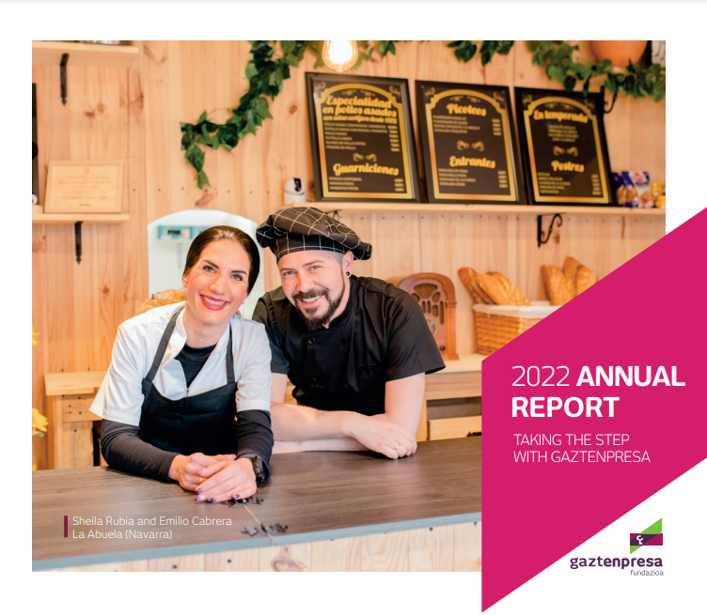

Slide 3
History
LABORAL kutxa is a cooperative bank launched in 1959, part of MONDRAGON Group.
In LABORAL Kutxa every worker is a partner, and the support and developing of new workplaces is part of its Mission. As a cooperative, it has always sought to reconcile business efficiency with the social principles of participatory democracy, self-help, community support and distributive justice.
In 1994, as a result of the industrial restructuring suffered, the left bank of the Nervion river, a zone specialized in heavy industry near Bilbao, appeared very deteriorated, reaching levels of youth unemployment of 50%. In this situation, a group of people (directors of the branches of LABORAL kutxa) in the area began mobilizing, pooling their knowledge and resources, while seeking partnerships to find answers to this situation.
In this context, Gaztempresa arises as a business ideas competition organized by the directors of the branches of LABORAL kutxa and supported by Bultz-Lan Consulting (an entity of Caritas – part of the Catholic Church, to support self-employment). The experience was quite satisfactory and 10 companies obtained microfinancing and were created that first year.
In the next years, the programme was extended to other territories, following the initiative of a group of Caja LABORAL’s workers who, also voluntarily, wanted to transfer this good practice.
Thus, Fundación Gaztempresa was set up on 16th September 2002 as a result of the above described intra-entrepreneurship process, being its first task to unify criteria between territories in order to continue with Gaztempresa program's philosophy

Slide 4
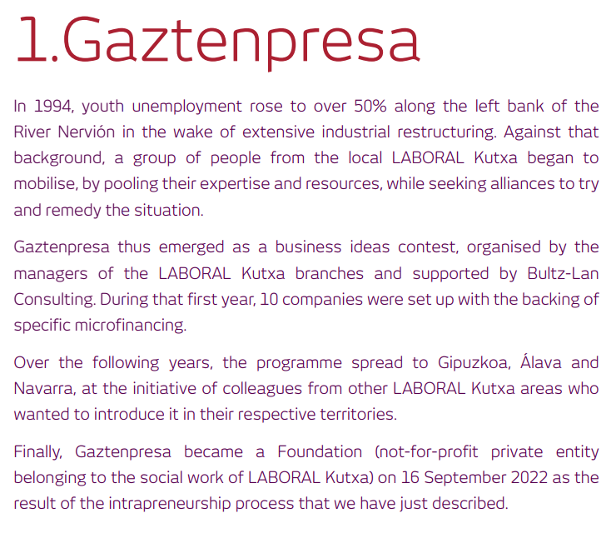
.

Slide 6
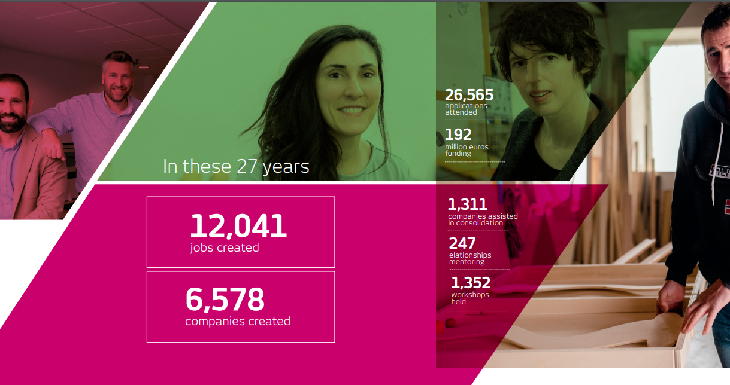

Slide 7
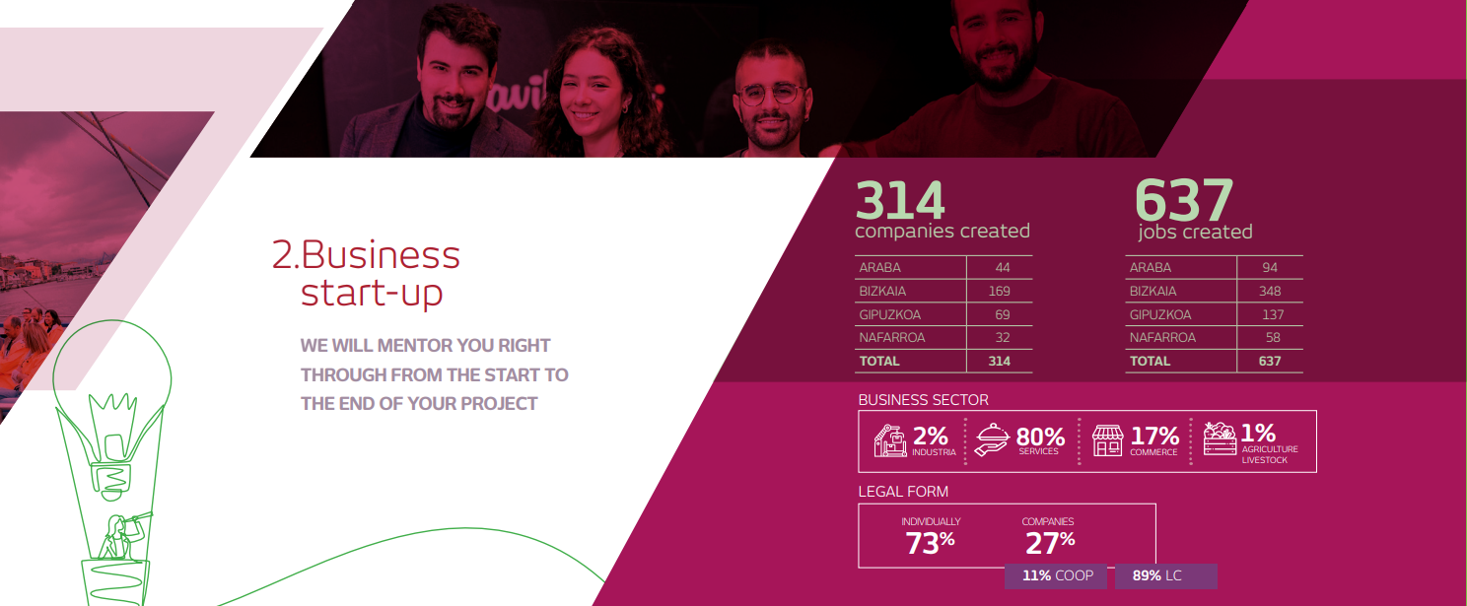

Slide 9
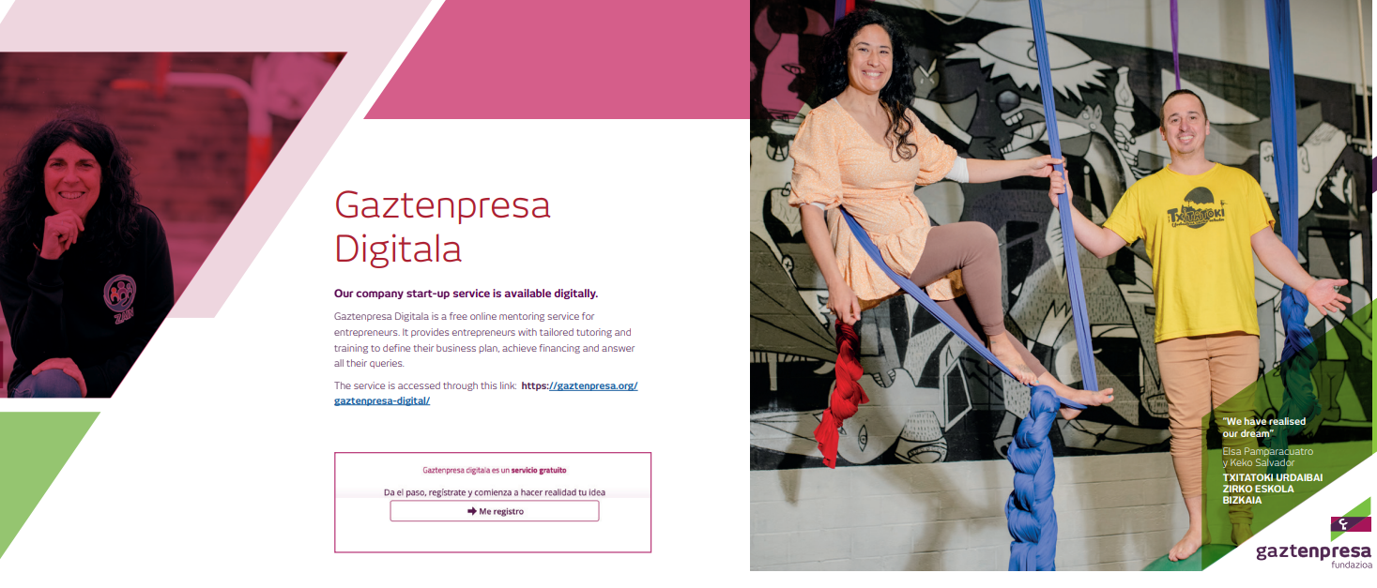

Slide 10
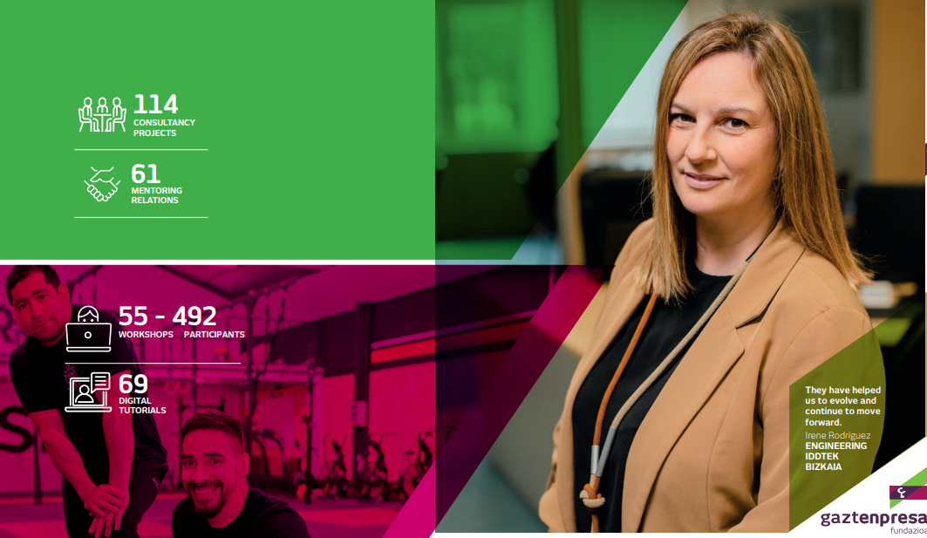

Slide 13
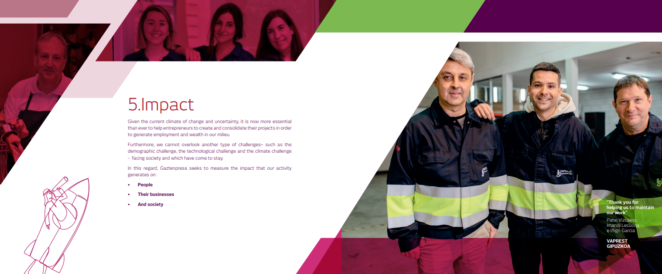

Slide 14
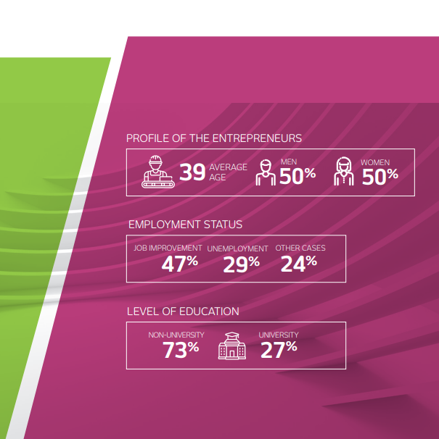

Slide 15
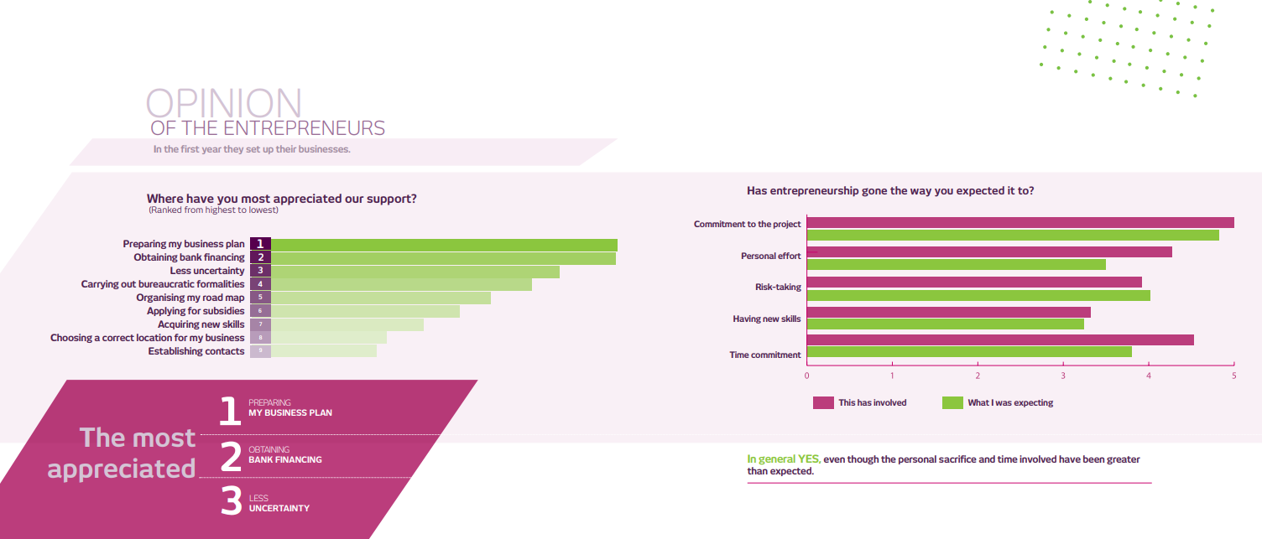

Slide 16
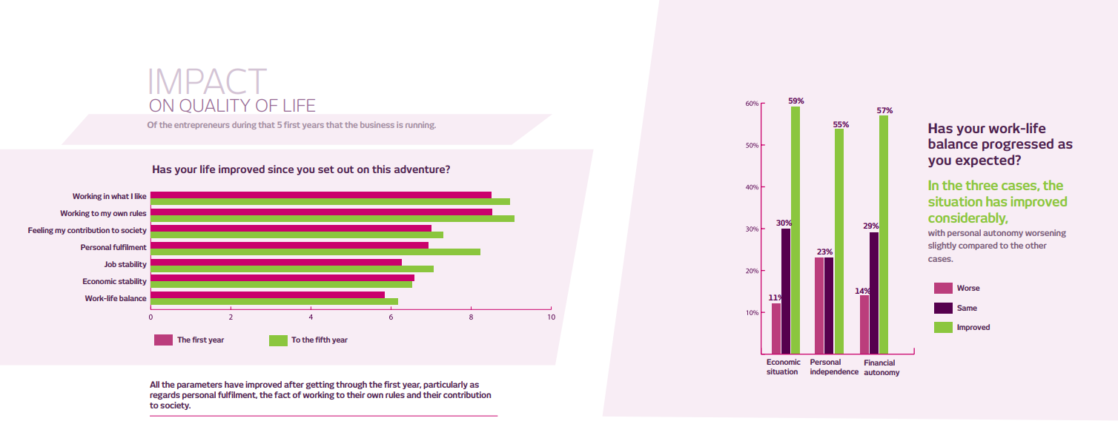

Slide 18
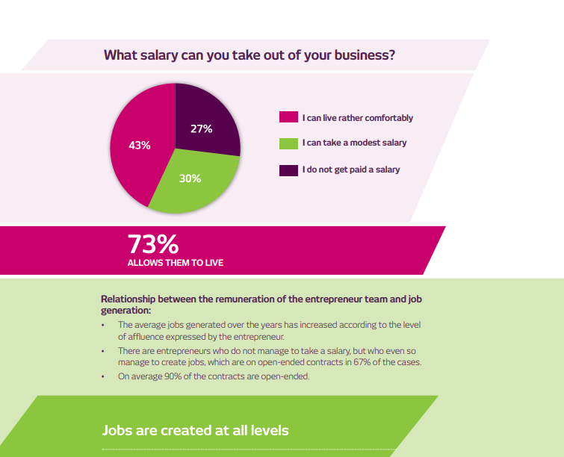

Slide 19
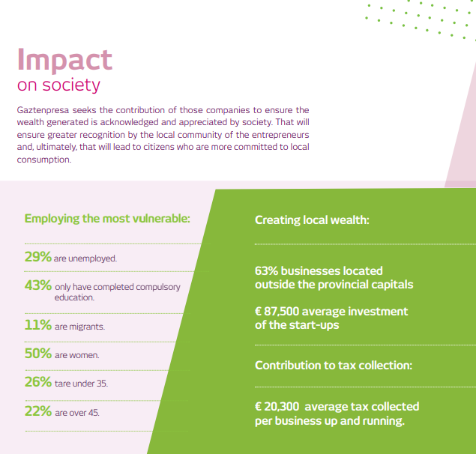
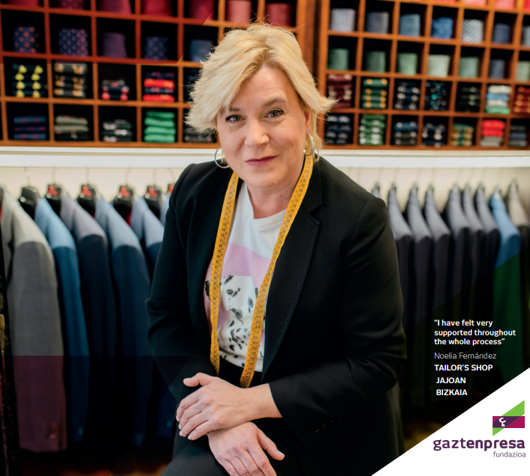

Slide 20
